Slide 1
Week 4: Setup NVIDIA Jetson Xavier NX Development Kit
Thursday, 2nd February 2023

Slide 2

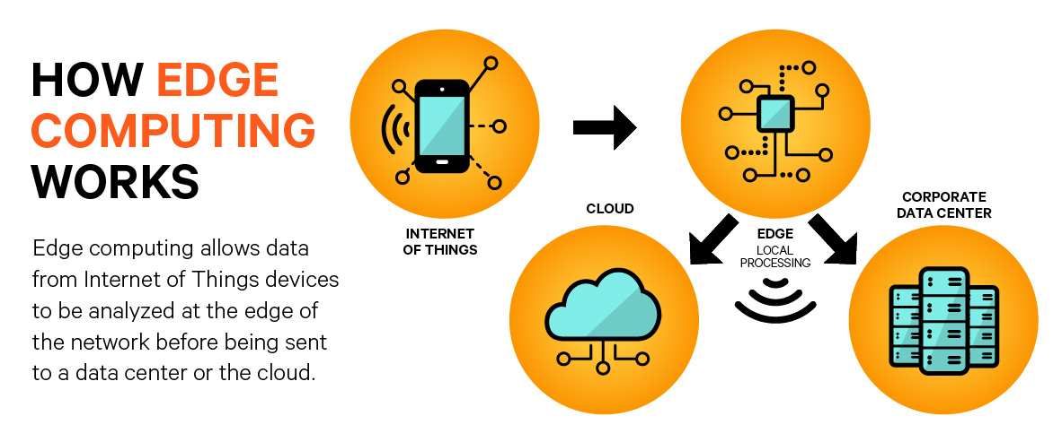
What is Edge Computing?
Brings computing resources as close to originating source of data
https://tinyurl.com/2h3kjzhm
https://tinyurl.com/yckzkfj9

Slide 3

Applications of Edge Computing
Autonomous vehicles
Healthcare industry for patient monitoring
Digital agriculture systems
Smart homes
Smart cities
Aerial and ground robots
https://www.google.com/imgres?imgurl=https%3A%2F%2Fwww.lanner-america.com%2Fwp-content%2Fuploads%2F5_examples_of_edge_computing.png&imgrefurl=https%3A%2F%2Fwww.lanner-america.com%2Fblog%2F5-examples-edge-computing-solutions-use-today%2F&tbnid=U88atFSp_3PjoM&vet=12ahUKEwim6MWsuNT8AhVF6ckDHewDBt0QMygZegUIARD5AQ..i&docid=6NWrZ8adPey5wM&w=1200&h=550&q=edge%20computer%20project%20examples&client=safari&ved=2ahUKEwim6MWsuNT8AhVF6ckDHewDBt0QMygZegUIARD5AQ

Slide 4
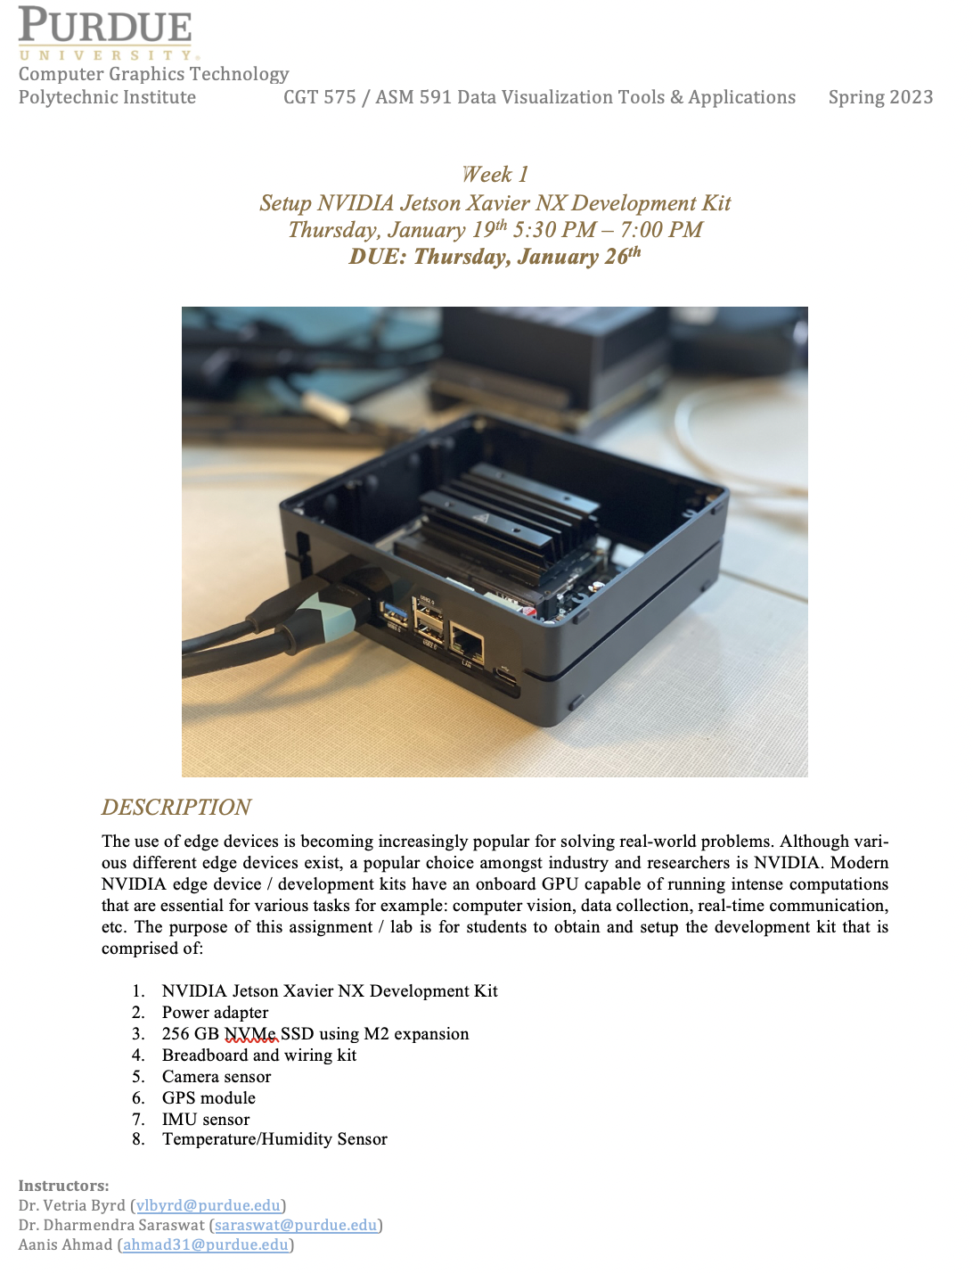
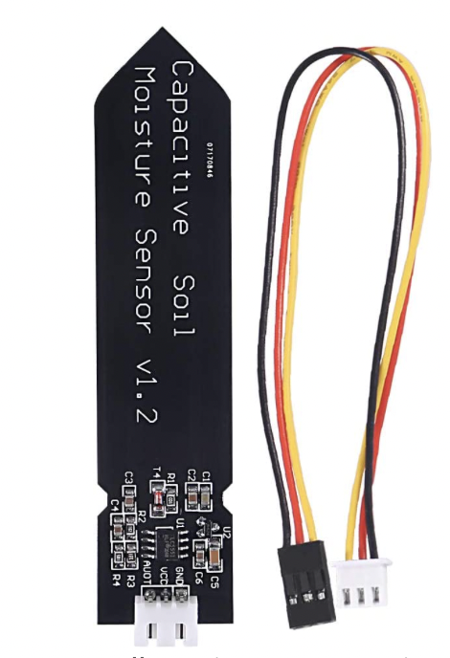
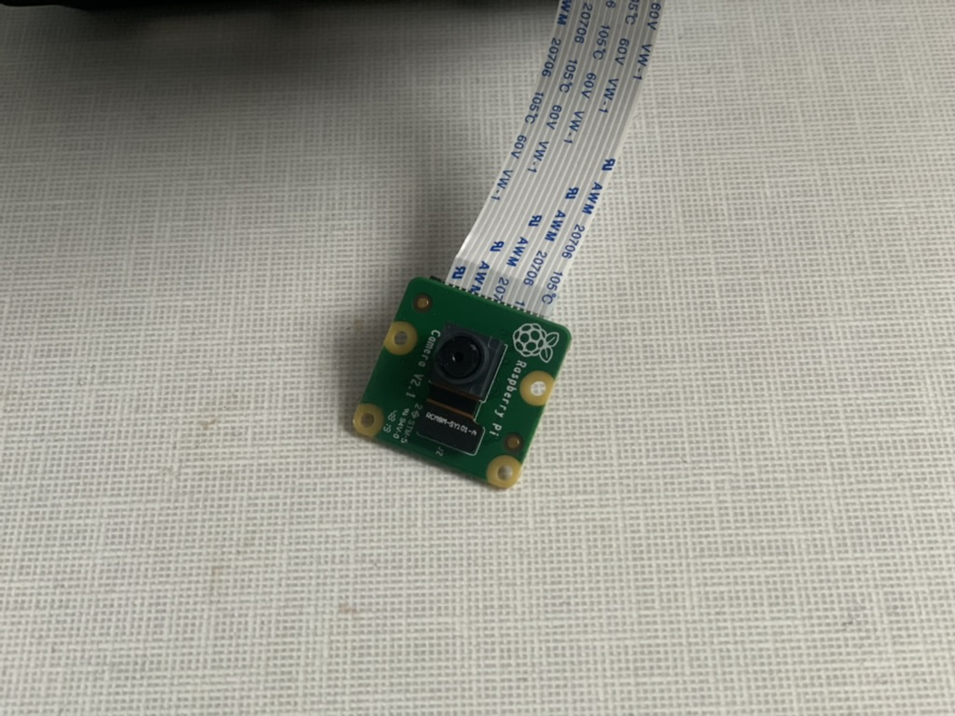
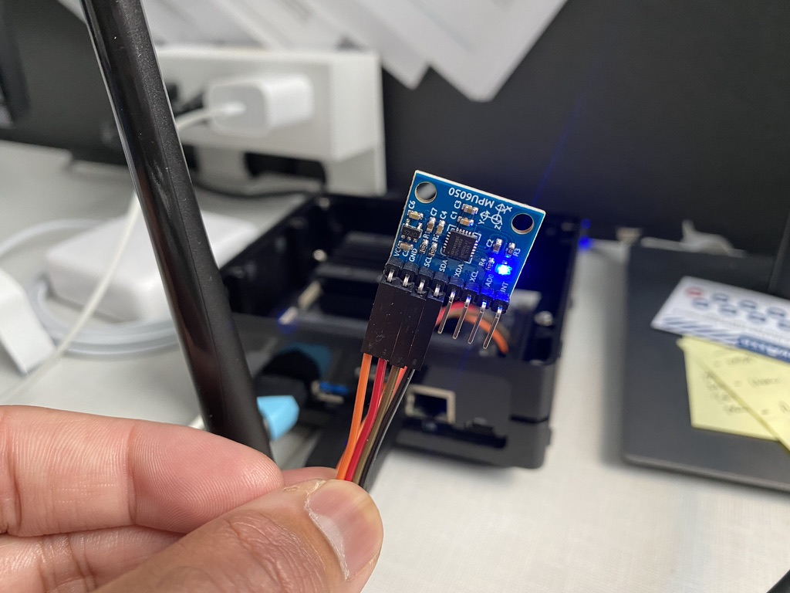
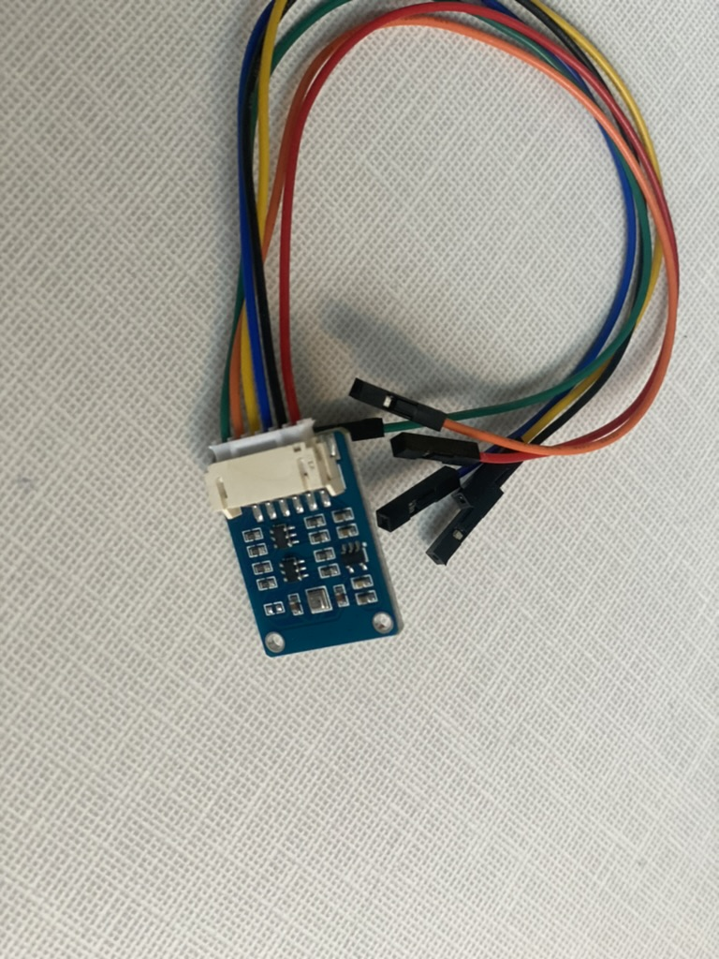
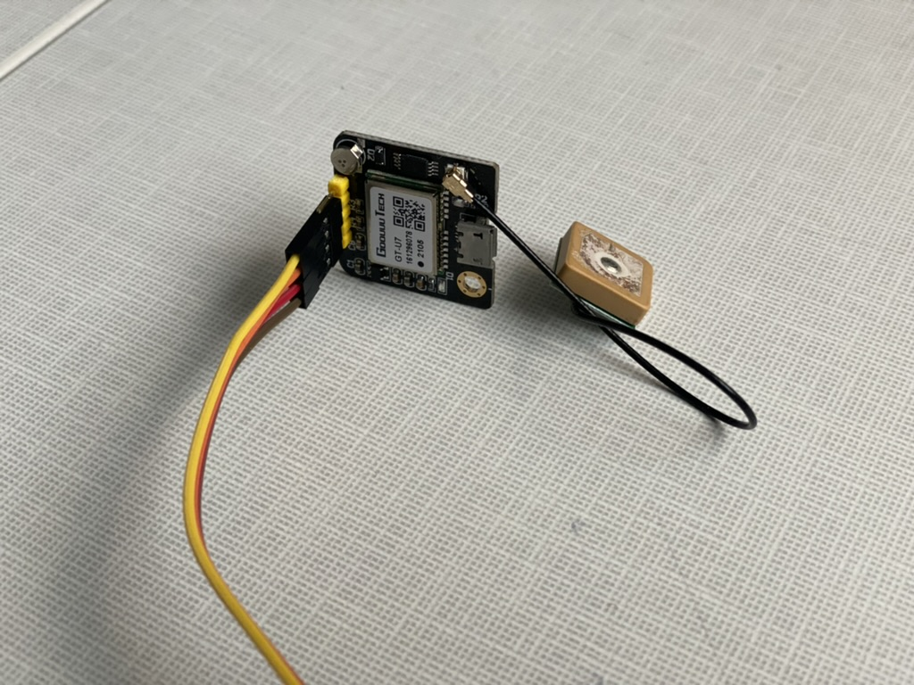
Edge Device Kits
NVIDIA Jetson Xavier NX
256GB NVM SSD
WIFI Adapter
Power Cable
Jumper Cable Set
IMU Sensor
GPS Sensor
Camera Sensor
Soil Moisture Sensor
Environmental Sensor

Slide 5
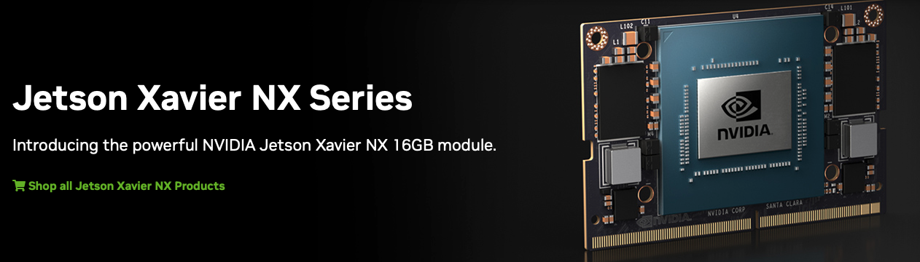
NVIDIA Jetson Xavier NX
https://www.nvidia.com/en-us/autonomous-machines/embedded-systems/jetson-xavier-nx/

Slide 6
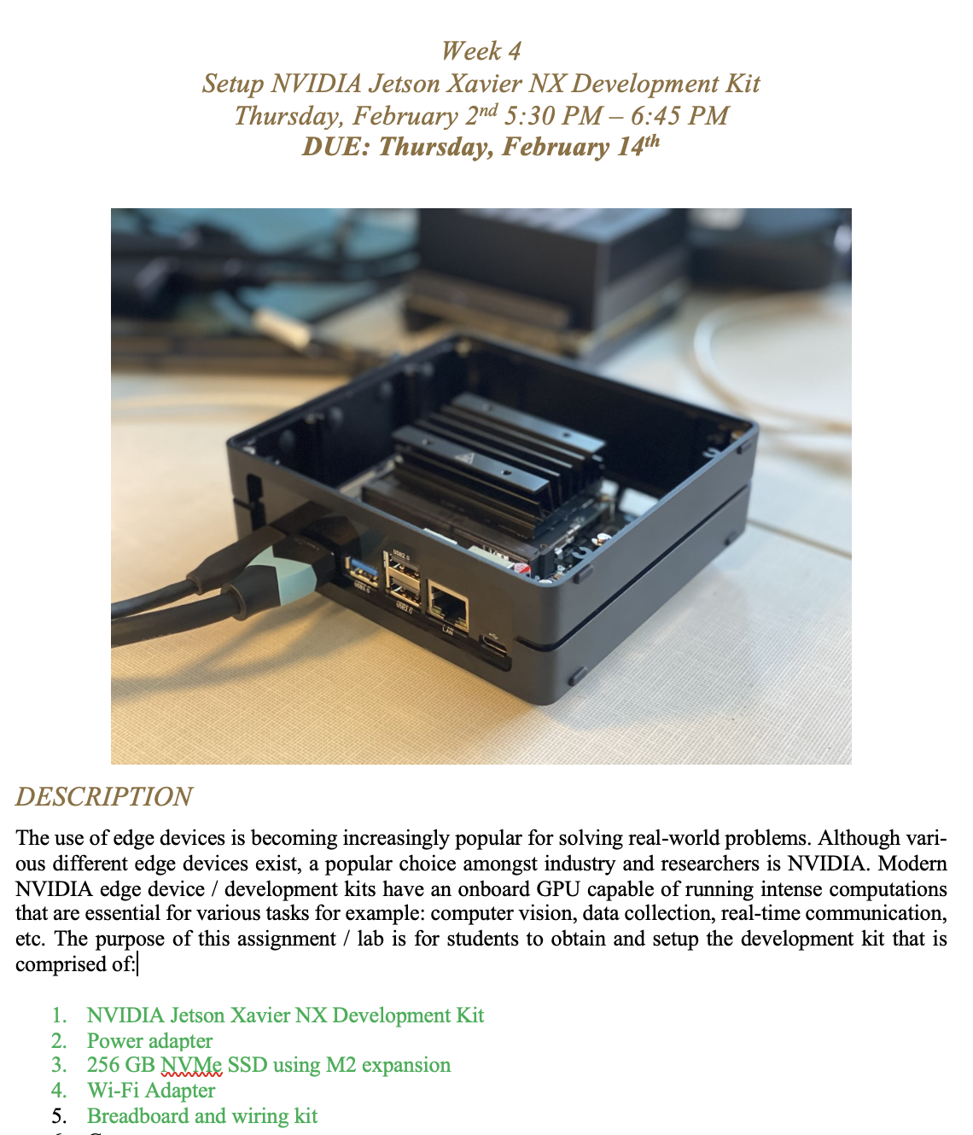
Task
Setup the Edge Computer

Slide 7
Today:
Complete Lab 1 Setup
Lab 1 Part 2: Due Next Tuesday

